Slide 1
JLab User Group Report to the Hall A Collaboration Meeting
Lawrence Weinstein
Old Dominion University
Jan 19, 2017

Slide 2
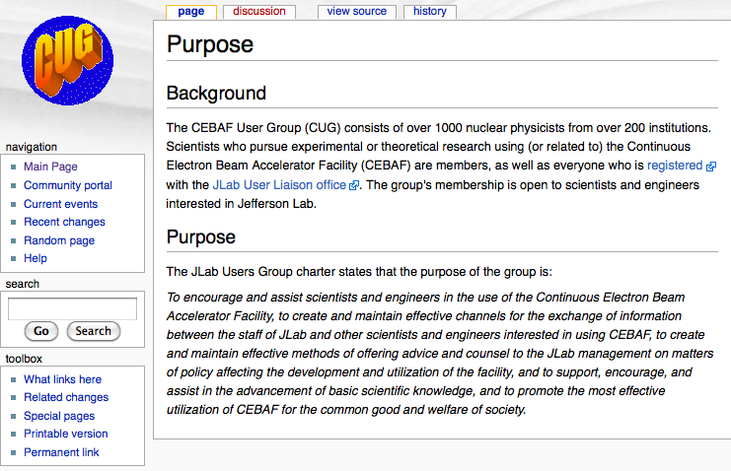
Who is the “Jefferson Lab Users Group”?
We all are.
https://wiki.jlab.org/cugwiki

Slide 3
Users Group Board of Directors (UGBoD)
Represents Users to JSA, JLab Management, and outside stakeholders
User representative on Director’s Safety Council
Chair gives user group update at JSA, SURA board meetings
Represents JLab Users to NUFO
Follows up on User questions, comments, complaints, suggestions…
Organizes the Annual User Meeting and two satellite meetings (APS April and DNP Fall meetings)
Meets twice annually each with JLab leadership, JSA representatives
Manages awards (Thesis Prize, Postdoc Prize, Poster Prize…)
Represents Users in evaluating JSA Initiatives Fund requests

Slide 4
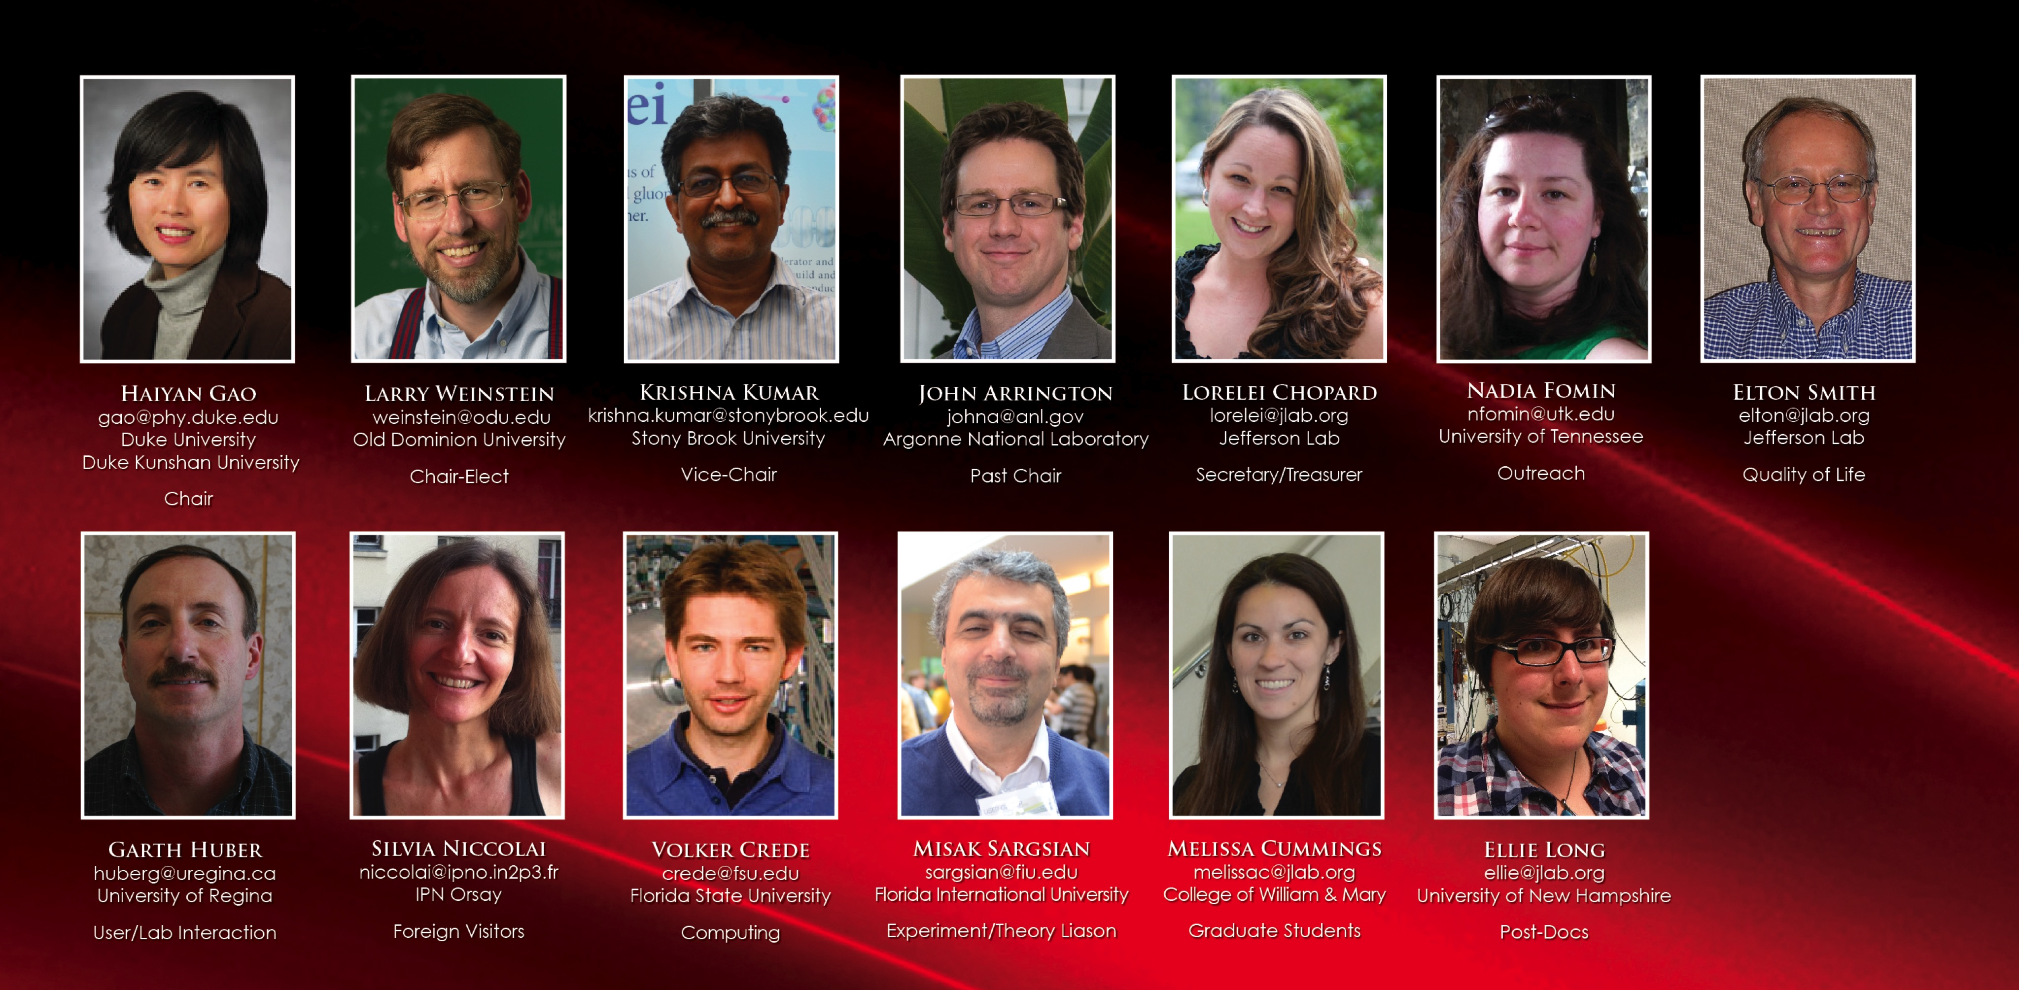
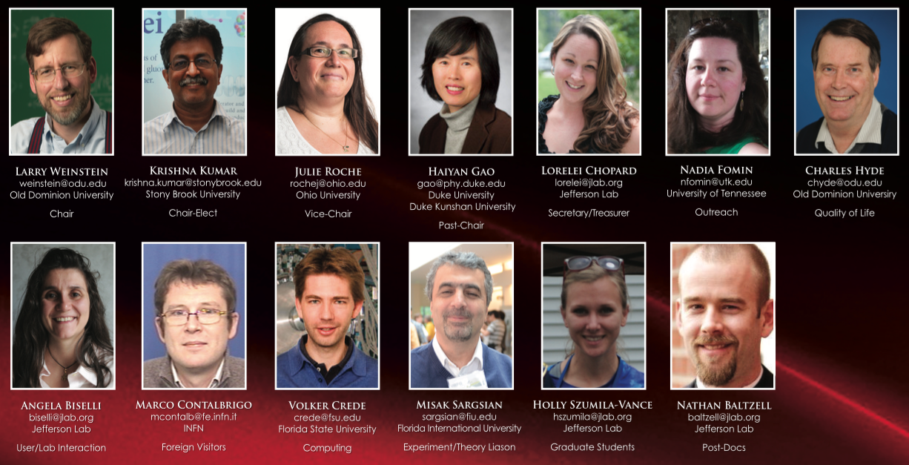
Users Group Board of Directors (UGBoD)
Chair: Lawrence Weinstein [ODU]
Chair Elect: Krishna Kumar [Stony Brook]
Vice Chair: Julie Roche [Ohio U]
Past Chair: Haiyan Gao [Duke]
Secretary/Treasurer: Lorelei Chopard [Jefferson Lab] (staff)

Slide 5
Users Group Board of Directors (UGBoD)
Charles Hyde (Old Dominion U): Quality of Life
Volker Crede (Florida State U): Computing
Angela Biselli (Fairfield U): User/JLab interaction
Nadia Fomin (U of Tennessee): Outreach
Marco Contalbrigo (INFN Ferrara): Foreign Visitors
Misak Sargsian (Florida International U): Experiment/Theory Liaison
Nathan Baltzell (Jefferson Lab): Postdocs
Holly Szumila-Vance (Old Dominion U): Graduate Students

Slide 6
UGBoD Activities
(mostly supported by JSA Initiatives Fund)
Satellite meeting at the DNP Fall Meeting
Select the winner of the postdoc prize (February)
Select the winner of the thesis prize (April)
Satellite meeting at the APS “April” Meeting
Nuclear Physics Day visits to DC (usually March)
Identify/recommend candidates for DNP Executive Committee (May)
Annual Users Group Meeting (June)
During the Meeting: Select and award Poster Prize winners
Science exhibition on Capitol Hill (June) (organized by NUFO)

Slide 7
Director Search
Two user representatives on search committee
User Group met with search committee to discuss Lab and Director priorities
User Group leadership consulted with search committee chair
User Group Board Priorities: New Director should:
Build on the success of 12 GeV upgrade
Put physics first
Reduce the administrative overhead and the administrative burden on physics and accelerator operations

Slide 8
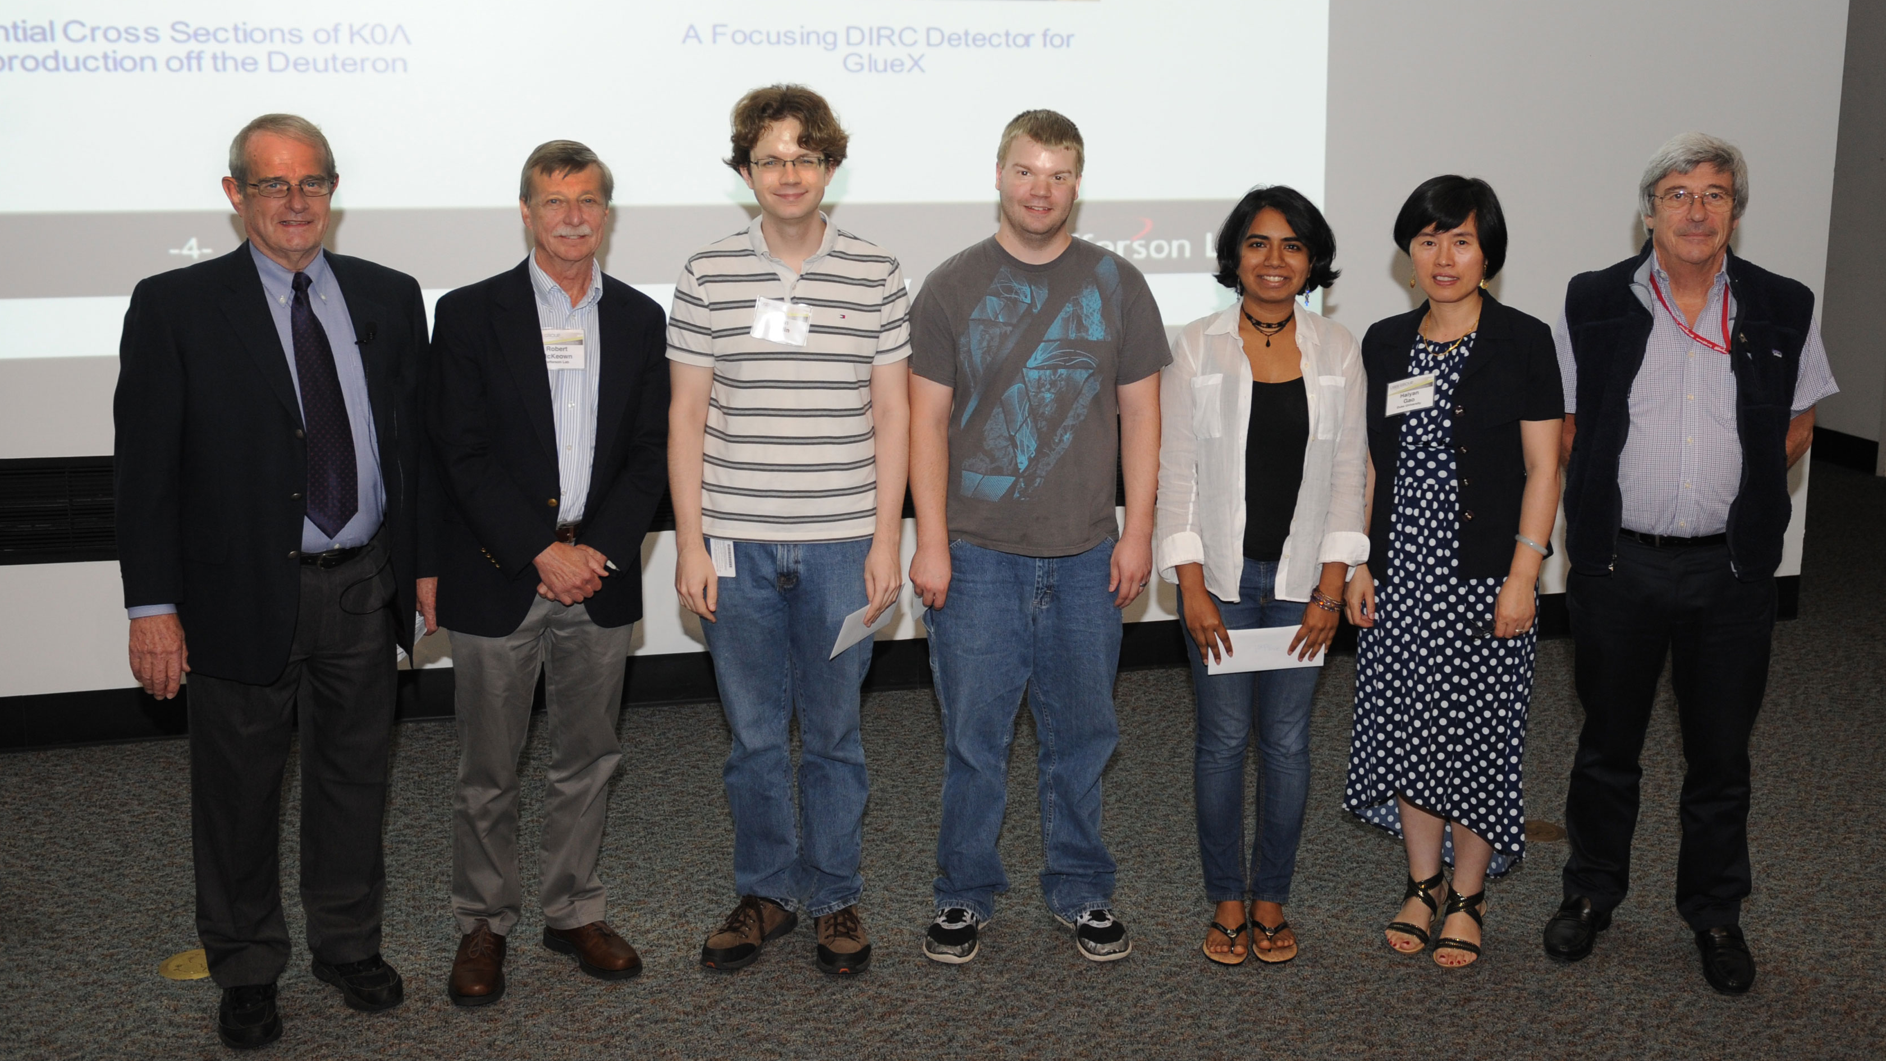
2016 Poster Prize Winners (funded by JSA Initiatives Fund)
1st Place: Abha Rajan (UVa)
2nd Place: Nicholas Compton (Ohio U)
3rd Place: John Hardin (MIT)

Slide 9
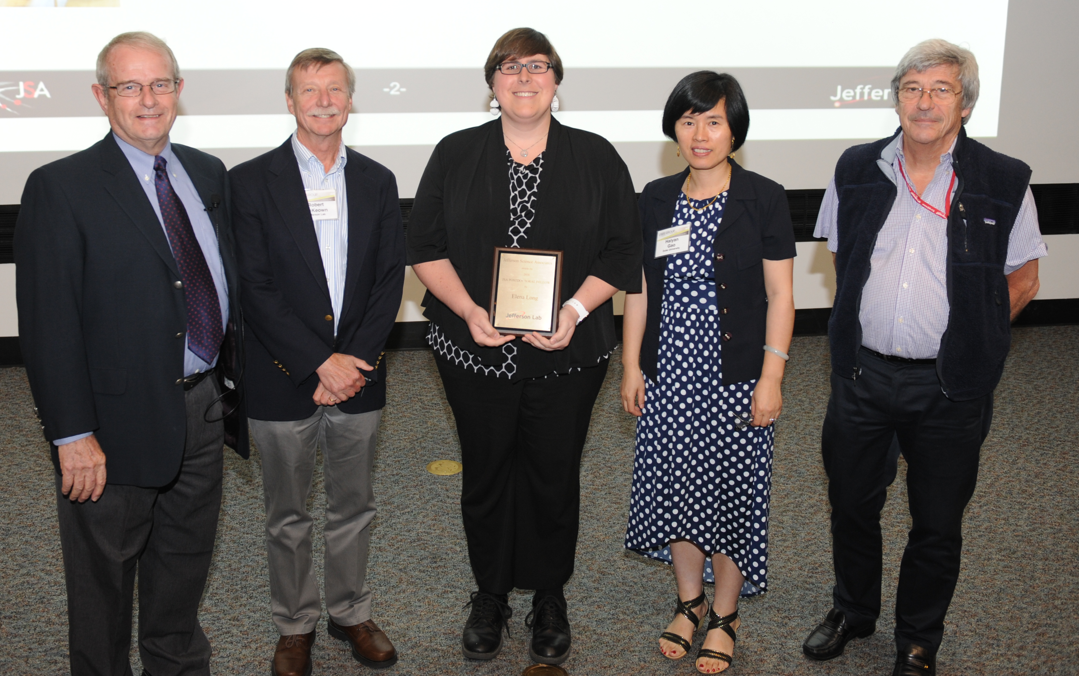
Postdoc and Thesis Prizes (funded by JSA Initiatives Fund)
2016 Thesis Prize
Or Hen (Tel Aviv U)
Now an MIT Pappalardo Fellow
2017 nominations due 2/24
2016 Postdoc Prize
Ellie Long (UNH)
2017 nominations due 1/27

Slide 10
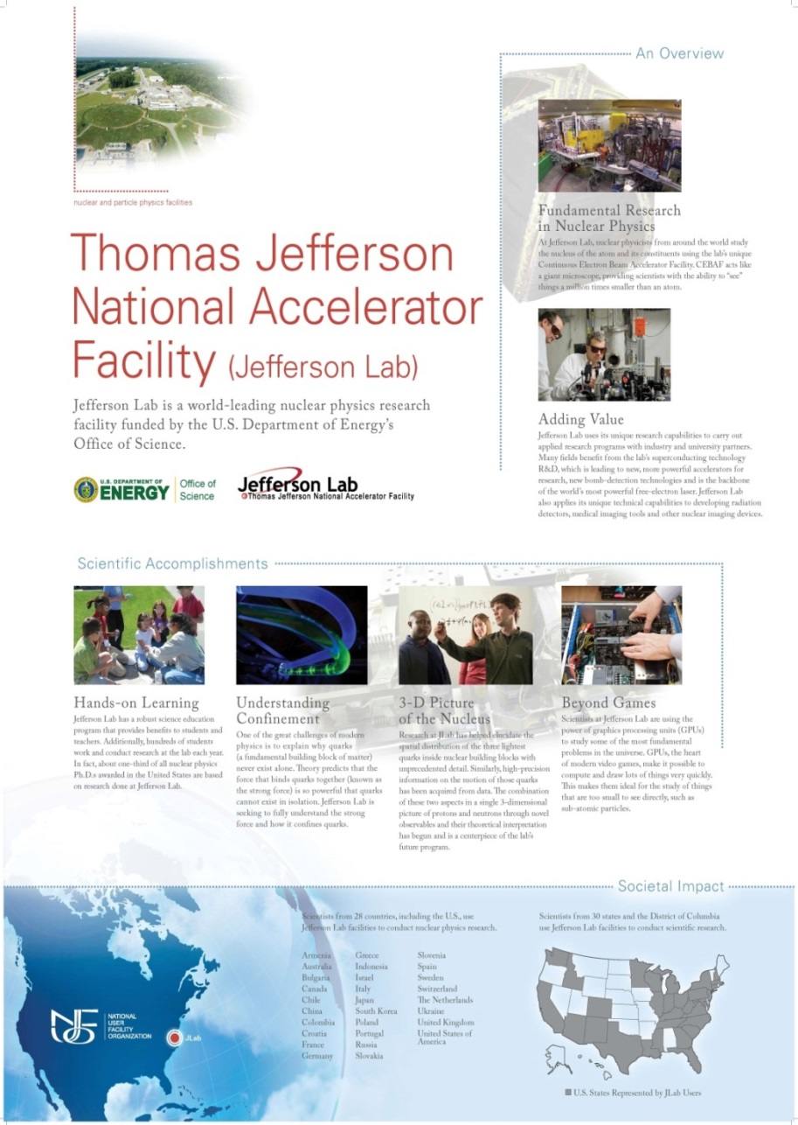
Outreach
Nuclear Physics day Capitol Hill visits (March)
NUFO (National User Facility Organization) Science exhibition Capitol Hill (June)
Inform users of important issues
Encourage contact between users and their representatives in congress
Nadia Fomin is UGBoD member leading outreach efforts
JSA Initiatives Fund helps support Nuclear Physics day on Capitol Hill
https://wiki.jlab.org/cugwiki/index.php/Nuclear_Physics_Day_on_the_Hill

Slide 11
Nuclear Physics on the Hill 2016
Jlab, RHIC and FRIB user groups meet with the offices of senators and representatives
4th year of Jlab involvement
24 Jlab user participants from 12 states
Join us in May 2017!

Slide 12
2016 Annual Meeting
Special talk by Barry Barish (Caltech)
on Gravitational Waves
Workshop Theme: Reaching for the Horizon – the 2015 Long Range Plan
Featured outside speakers:
Chen-Yu Liu (Indiana)
Giorgio Gratta (Stanford)
Alexandra Gade (Michigan State)
Krishna Rajagopal (MIT)
177 participants including 67 students
Funded by JSA Initiatives Fund
Planning now for 2017

Slide 13
Summary
User group concerns:
Accelerator performance
Lab budget and available running time
Helping smooth the lab director transition
Your issue here
We’re here to represent you
Tell us your concerns so we can communicate them to the Lab

